Slide 1
Net Tuition Revenue Primer
When Processes Cause Financial Shortfalls that Headcount Cannot Fix
A Precursor to AACRAO SEM
First Week in November 2026
Baltimore, MD
August 26, 2026: Dr. Steve McKellips, Vice Provost, TTUHSC

Slide 2
WE NEED MORE REVENUE!
The ONLY Two Ways to Get Revenue
  Assess it correctly.
  Collect it right correctly.
Let’s Look at Both More Closely.
August 26, 2026: Dr. Steve McKellips, Vice Provost, TTUHSC

Slide 3
Net Tuition Revenue (NTR)
What NTR IS:
  Definition:
    The amount of cash received by the university from tuition after all discounts are subtracted.
  Key Terms:
    Cash
    Tuition
    University
    AFTER
How it is USED:
  Pay for institutional expenses after all other revenue sources expire.
    Fiscal year expenses, summed from everyone enrolled “this year.”
August 26, 2026: Dr. Steve McKellips, Vice Provost, TTUHSC

Slide 4
Net Tuition Revenue (NTR)
What NTR IS NOT…
  … Another Word for Tuition (Common misperception)
    It is how much of 100% tuition really gets collected.
  … A Campus Statistic that Lives in Your Data Somewhere (Missed opportunity)
    It’s “live data.” It is the sum of individual student outcomes in any given year.
  … the Opposite of Discount Rate (Oversimplification)
    Discounts awarded to students are not intended to target tuition when awarded.
    Discounts can be added for other reasons (housing, AGI, corporate partner, etc.)
  … A Proxy, Synonym, or Extrapolation for Enrollment Headcount (Danger)
    Cannot divide a total number by tuition to identify a headcount of anything.
    A static variable, so the total is always fluctuating.
  … Typically Tracked as an Individual Line-Item on Financial Ledgers (Oversight)
    Manifestations of NTR come from showing Gross Revenue and a “Scholarship Line.”
    Often, no “NTR line” exists because it is inferred within the math.
August 26, 2026: Dr. Steve McKellips, Vice Provost, TTUHSC

Slide 5
Understanding Your Financial Aid Leveraging Strategy (2 Examples)
Evaluate the Net Tuition Revenue Position of Your Strategy at the Per-Student Level.
Determining if It Works the Way the Institution Needs in the Big Picture.
August 26, 2026: Dr. Steve McKellips, Vice Provost, TTUHSC

Slide 6
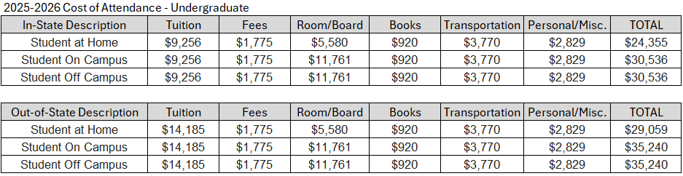
FA Leveraging Focused on COA
COA calculations include direct/indirect billed expenses.
Institution keeps Tuition. Fees/Room/Board redirected internally.
August 26, 2026: Dr. Steve McKellips, Vice Provost, TTUHSC

Slide 7
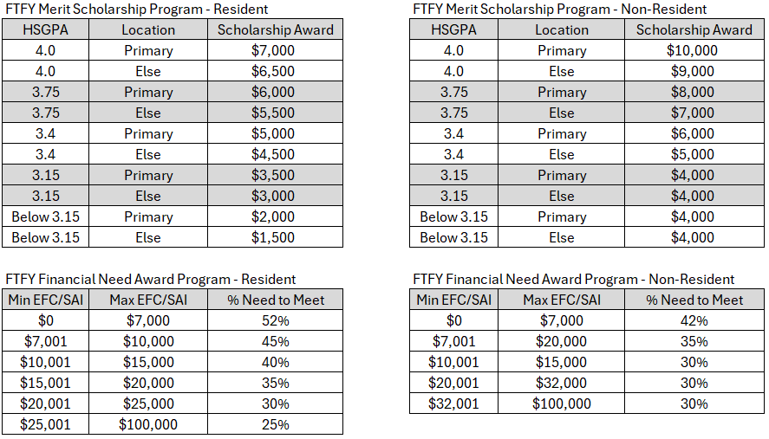
Example 1: Receives Merit + Need (% of COA)

Slide 8
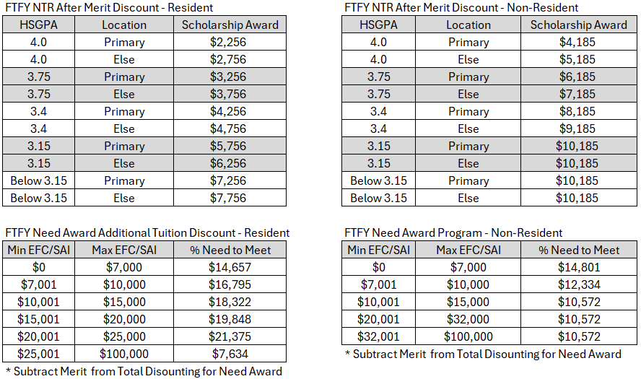
Converting COA % into Discounted Dollars

Slide 9
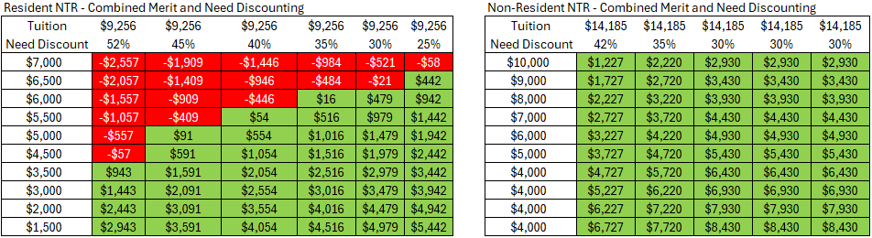
Leveraging Plan: Calculating NTR with Example 1
All “Discounting” is “Tuition Discounting.”
  Discount totals are always subtracted from tuition, regardless of labeling.
Plans to remove costs of non-tuition elements (housing, meals fees, etc.) cannot be subtracted from those elements.

Slide 10
FINANCIAL RISK: “Successful” Enrollment Growth
All NTR calculations reflect tuition revenue totals against $0.
Growing enrollment from per-student revenue positions that are negative means the institution loses money with each.

Slide 11
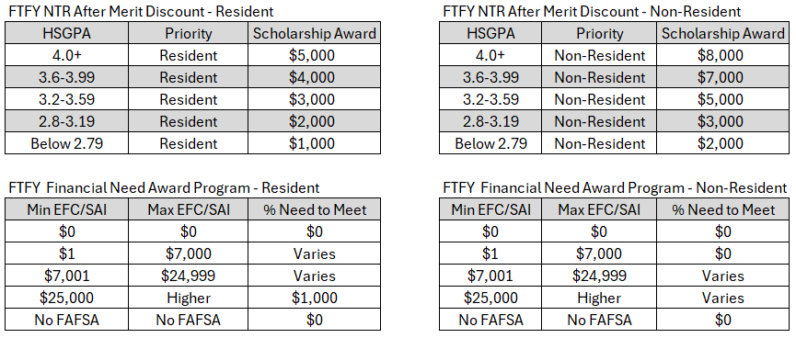
Example 2: Receives Merit + Need (Fixed $)
August 26, 2026: Dr. Steve McKellips, Vice Provost, TTUHSC

Slide 12
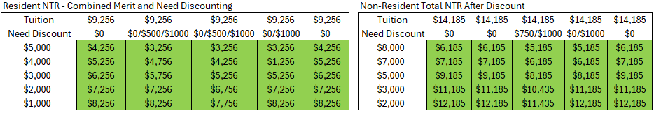
Leveraging Plan: Calculating NTR with Example 2
All NTR calculations reflect tuition revenue totals against $0.
Growing enrollment from per-student revenue positions that are negative means the institution loses money with each.
  Similarly, growing enrollment from per-student revenue positions that are positive does not ALWAYS mean increases in NTR. WHY?

Slide 13
2 Leveraging Plans – Per/Student $ Comparison

Slide 14
Two Examples: Same/Different: Better/Worse?
Is one leveraging plan inherently good and the other bad?
  How can you tell?
Has anyone at your campus calculated the financial impacts of your leveraging strategy?
  What is it supposed to look like?
Which one is more likely to increase enrollment?
  Would that be a good thing?
What does each leveraging plan say about your institution’s long-term enrollment planning?
  Is that important to know?
August 26, 2026: Dr. Steve McKellips, Vice Provost, TTUHSC

Slide 15
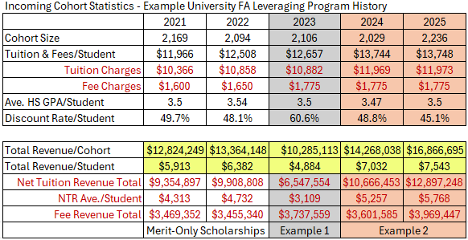
One Place Used Both Examples
Change - 2022 to 2023
  Headcount Growth
  NTR Loss
Change - 2023 to 2024
  FAFSA Debacle
  Headcount Loss
  NTR Growth
Watch Total Revenue
  Watch Total Revenue/Student
August 26, 2026: Dr. Steve McKellips, Vice Provost, TTUHSC

Slide 16
The “Real” NTR Picture with Both Examples
Change - 2022 to 2023
  Headcount Growth
  NTR Loss
Change - 2023 to 2024
  FAFSA Debacle
  Headcount Loss
  NTR Growth
No Change - 2024 to 2025
  Headcount Growth
  NTR Growth
  Is it Enough?
August 26, 2026: Dr. Steve McKellips, Vice Provost, TTUHSC

Slide 17
Losing Money While Collecting It
Evaluating the Revenue Collected against the Revenue Expected.
Determining if the Billing Infrastructure is Performing Correctly in the big picture.
August 26, 2026: Dr. Steve McKellips, Vice Provost, TTUHSC

Slide 18
Where is Aggregate Tuition Found?
Do you know how much tuition your institution bills in the aggregate each year?
  Who does? How do they know?
  Might they know instead how much was collected (which is different)?
Does anyone ever talk about how much tuition is expected?
  Where is that information found?
  How is it calculated? How is it reported? Does anyone know?
Typically, “Annual Tuition” presents as an aggregated total on an institution’s financial ledger, but that’s a past-tense observation.
  How does that number come to be, and who calculates it?
August 26, 2026: Dr. Steve McKellips, Vice Provost, TTUHSC

Slide 19
Do You KNOW if It’s Right?
Institutions typically run student billing through an automated process “internally” within the “student information system” that operates on their campus.
  Who programs these systems?
  How are potential errors identified?
  What constitutes an error?
  Who is supposed to notice?
What is the confidence level that the “right” amount of student billing occurs each cycle?
  How do you KNOW if it’s right? I get that many may THINK it is.
  Things change…
August 26, 2026: Dr. Steve McKellips, Vice Provost, TTUHSC

Slide 20
Example: State Law Change to Guaranteed Tuition
Effective Fall 2018 for all baccalaureate-providing, state universities.
Universal implications for all state institutions:
  Covered tuition and traditional student fees (not course fees, etc.)
    Institutions could choose to include more costs (Housing, etc).
    Once included, it became part of the “Guarantee” moving forward.
  Only the IN-State tuition rate was frozen.
    Each cohort could increase, within state requirements, but then that final number would freeze.
  4-Year tuition guarantees begin with matriculation.
    Applied to ALL DEGREE-SEEKING STUDENTS.
  Regional rates for external campuses expected to freeze also.
  All “Continuing Students” were frozen at Fall 2017 rates moving forward.
    Annually, the state annually reviews if the Fall 2017 will be increased (never has).
August 26, 2026: Dr. Steve McKellips, Vice Provost, TTUHSC

Slide 21
Campus Responses Push (Even) More Affordability
Institution opted to expand the construction of the guarantee more broadly for students.
  Included a freeze for non-residents.
    Reinterpreted Non-Resident billing into a more convenient “Non-Resident Tuition” number (a flat $15,500 for non-residents as a singular expense)
      Procedurally, Non-residents billed with 2 charges:
        In-State tuition applied to everyone.
        Non-resident surcharge added to the total.
  Included housing.
    Housing prices were calculated for each facility.
    Had to get approval from the state to increase housing costs.
  Included regional campus.
    Law didn’t specify regional campuses
    Most campuses added their own versions of the guarantee for consistency.
August 26, 2026: Dr. Steve McKellips, Vice Provost, TTUHSC

Slide 22
Complexity: Institutions Had to Rebuild Their Billing
Tuition Guarantee changed the billing paradigm entirely.
  Everyone HAD BEEN charged the same rate per credit
    Now, simultaneous rates running at the same time (increased by another 1 for 6-years)
    Ultimately, Fall cohorts in 2018, 2019, 2020, etc. all billed different in-state tuition rates.
  “Non-resident Surcharge” rates were different for each cohort because the in-state tuition changed for each of them.
    Campus chose to honor the freeze for those students also.
  Each cohort year had different student fee rates.
    Had to charge a unique tuition rate and a unique student fee rate for every UGRD student. (6x)
    Establishment of a tuition guarantee rate and student fees at the regional campus.
      Created 13x tuition models, 13x student fee models -> ALL UGRD
Every part of the programming language had to be addressed.
  Definition of term of entry.
  Definition of degree-seeking.
  Continuing Students
    Literally continuing (retention/progression) v. State’s definition (previously enrolled in 2017)
August 26, 2026: Dr. Steve McKellips, Vice Provost, TTUHSC

Slide 23
6 Years Later – Discovered Problems
Tuition billing from entry levels were maintained.
  Extended to “continuing” graduate students – Unintended in law.
  Dual Enrollment billing rates continued for students who matriculated in the fall.
Regional Campus:
  Scholarships applied against regional rates with Main dollar values.
  No record-keeping of where the student is now, just the application.
  Dual Enrollment billing rates continued for students who matriculated in the fall.
Undecided and Pre-Majors were treated as Non-Degree, assigned the 2017 rate.
Non-residents were imagined to be frozen at $15,500 for tuition and fees.
  Non-resident surcharges (technically unfrozen) reduced around the in-state tuition rate increases to hold the aggregate in place.
    No non-resident rate by cohort – so, every NR was charged the same, reducing NR rate annually (which was determined at the new cohort level regardless of cohort year).
  Every non-resident was given a $3,000 scholarship to bring pricing down to match the in-state tuition.
    Recruitment innovation to urge enrollment increases in NR students.
August 26, 2026: Dr. Steve McKellips, Vice Provost, TTUHSC

Slide 24
Time to Fix Them
University was missing the collection of the money that students were expecting to pay for college.
  Never recalculated any billing – whatever it was when a student first-entered stayed with the student annually.
  Freezing non-resident totals significantly reduced the rightfully expected non-resident tuition revenue the institution charged.
  Undecided and Pre (Business, Nursing, Engineering) students were charged the 2017 rate as continuing, non-degree students, never changed.
    Applied this 2017 rate to non-residents and international students as well, if they had selected undecided or one of the pre-major programs.
Scholarships were awarded in full against partial tuition charges.
  Impacted non-resident students who received larger scholarship totals, those attending regional campuses, or were assessed a tuition discount (dependent on employee, etc.).
  FA packaging components were applied in full against the bill (Pell, Loans, etc.)
After 6 years, the missing tuition per credit grew to $125 for incoming cohorts.
  Over 2017 rate, though each cohort delta was smaller as tuition growth progressed.
Large refunds for students who received large FA package components.
  FA leveraging strategies (Example 1 and Example 2) overlay these discoveries.
August 26, 2026: Dr. Steve McKellips, Vice Provost, TTUHSC

Slide 25
Cost Implications and Corrections
NOBODY SAID A WORD.
  $125 per credit x 24 credits = $3,000 per student, per year for each cohort (Undecided/Pre-Major).
    Applied to 15% of the institution’s total enrollment.
    Applied to approximately 22% of the institution’s UGRD enrollment.
  Some students’ bills increased as much as $5,700/year when all the corrections applied.
Tuition determination run every semester to determine where students were enrolled.
  Developed specific cohorts that identify which students exist on regional campus and for what cohort year.
  Regional campus students were automatically charged ~60% of the main campus rate.
    Developed new scholarship rates that would apply for regional campus students, specifically (60% of the main campus rates).
    Prevented unintended over-awarding at the regional and the tuition increase when transitioning to Main Campus.
All UGRD and pre-major programs were billed correctly, both Main and Regional Campuses.
Standardized student fee rates and non-resident surcharge rates applied to all students.
  Same now for UGRD and GRAD students over the standard tuition.
  Removed the non-resident scholarship that brought the student down to in-state tuition rate.
    Was not increasing non-resident enrollment, but it was creating substantial over-awarding.
August 26, 2026: Dr. Steve McKellips, Vice Provost, TTUHSC

Slide 26
Handling Problems that are Too Big to Fix
Individual student impacts were significant.
Billing increases with NO FA INCREASE.
  FA was calculated correctly on assumed rates for all students
  FA had no connection to what was billed, but worked from spreadsheets/expectations
Increasing out-of-pocket expenses brings SIGNIFICANT RETENTION RISK.
  Impacted ~22% of the total UGRD population.
  Institution likely could not survive the risk to enrollment.
Corrected the errors; Applied an ‘administrative scholarship/grant’ to offset.
  Let students keep their experienced discounts moving forward.
    Notified impacted students of the error, communicated that they would keep the discounts.
      All but FTFY would keep the discounts throughout their graduation.
      FTFY were only 60 days into Year 1, so they could keep the discounts for Year 1. Stopped for Year 2.
  Corrected the billing where they could see it, showing both corrections and adjustments.
August 26, 2026: Dr. Steve McKellips, Vice Provost, TTUHSC

Slide 27
Financial Impact – Corrected in October 2025
Required ~$5M in scholarship offset adjustments to cover errors.
  Reflected the missing revenue the institution didn’t collect – that fiscal year.
    All levels, all types of students, all reasons for problems.
    Already lost for the fiscal year – just needed to correct it now.
  $2M was just in the FTFY cohort (largest group, 1-year impact).
    Attrition, progression, and graduation will take the rest out in time.
      Seniors would graduate right away, leaving only 2nd and 3rd year students.
      Graduate students would leave the institution within 2-3 years as well.
Institution’s financial ledger shows $50M in fiscal year tuition revenue (gross revenue – scholarships).
  Impact was roughly 10% of the institution’s expected revenue.
  Institution struggling financially, hiring freezes, unfilled positions.
    Within 3 academic years, missing revenue will be fully restored with new cohorts.
      Provided enrollment remains constant – no need for growth to achieve.
      Enrollment growth would/could push that revenue recovery higher.
August 26, 2026: Dr. Steve McKellips, Vice Provost, TTUHSC

Slide 28
Here is How $5M Goes Away in 3 Years
Missing revenue was now trackable in the system.
  Year 1: Fiscal Year 2025 - Already not receiving the money when discovered.
    $300,000 in missing revenue eliminated when Spring 2025 seniors graduate. - These students entered in Fall 2021 or earlier.
    $2,000,000 in corrected billing for Fall 2024 cohort starting Year 2 (Fall 2025). - These students entered in Fall 2024.
  Year 2: Fiscal Year 2026
    $400,000 in missing revenue eliminated when 2026 seniors graduate. - These students entered in Fall 2022 or earlier.
    $3,300,000 in corrected billing from Fall 2024 continuing with new Fall 2025 cohorts (residents and non-residents).
    $2,300,000 in continuing administrative scholarship discounts for impacted students.
      $3,300,000 - $2,300,000 = $1,000,000 in net tuition revenue increase in FY 2026 over FY 2025.
  Year 3: Fiscal Year 2027
    $1,000,000 in missing revenue eliminated when 2027 seniors graduate. - These students entered in Fall 2023 or earlier.
    $4,600,000 in corrected billing for Fall 2024 and 2025 continuing and new 2026 cohorts.
    $1,300,000 in continuing administrative scholarship discounts for impacted students.
      $4,600,000 - $1,300,000 = $3,300,000 in net tuition revenue increase in FY 2027 over FY2026.
  Year 4: Fiscal Year 2028
    $8,000,000 in missing revenue eliminated when 2027 seniors graduate. - These students entered in Fall 2023 or earlier.
    $500,000 in continuing administrative scholarship discounts for 5-year seniors yet to graduate from Fall 2023.
    $6,000,000 in corrected billing for Fall 2024, 2025, 2026 continuing and new 2027 cohorts.
      $6,000,000 - $500,000 = $5,500,000 in net tuition revenue increase in FY 2028 over FY2027.
August 26, 2026: Dr. Steve McKellips, Vice Provost, TTUHSC

Slide 29
Questions or Comments:
Dr. Steve McKellips
Vice Provost for Enrollment and Student Services
steve.mckellips@ttuhsc.edu

