Slide 1
AACRAO-AICE SURVEY

Slide 2
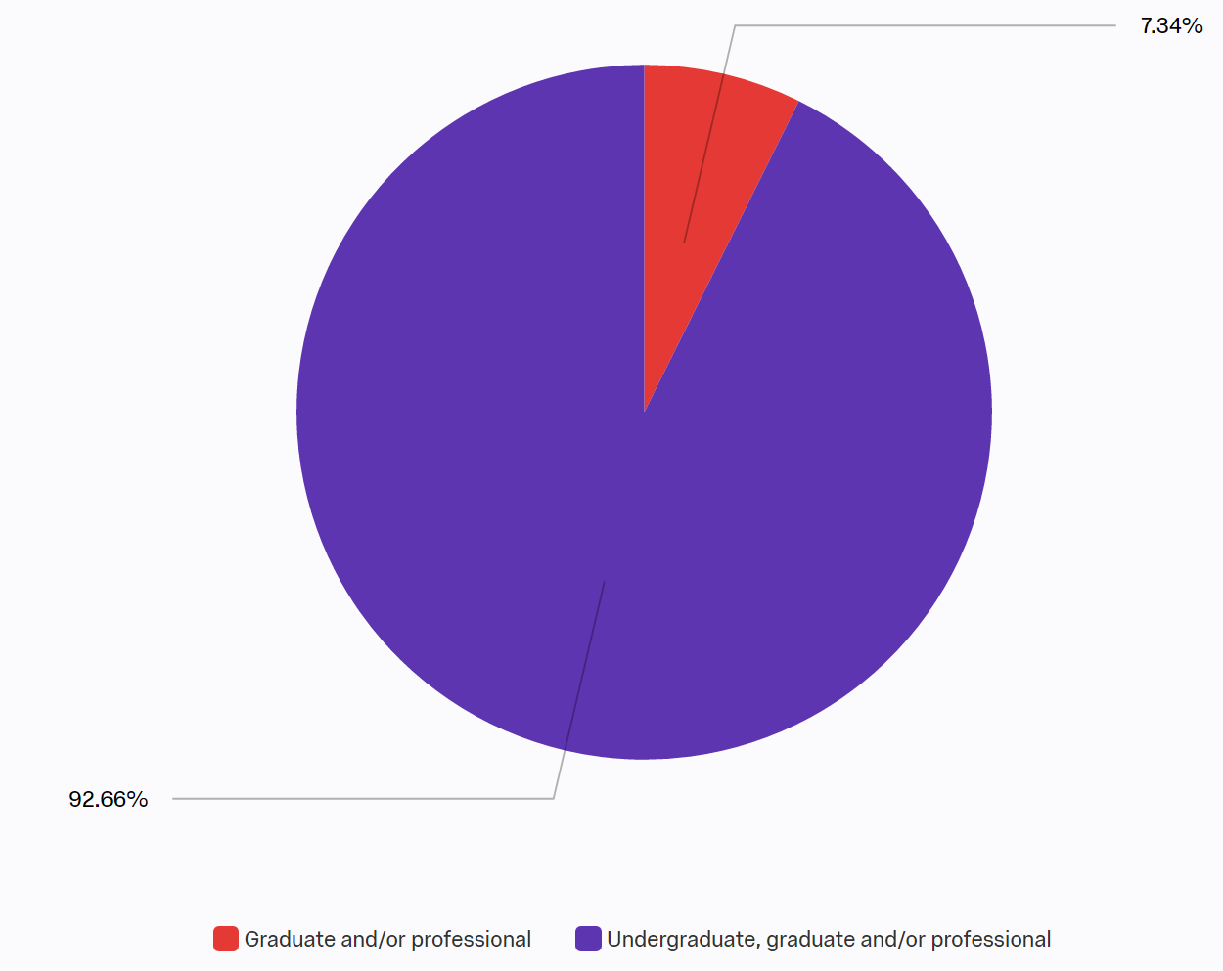
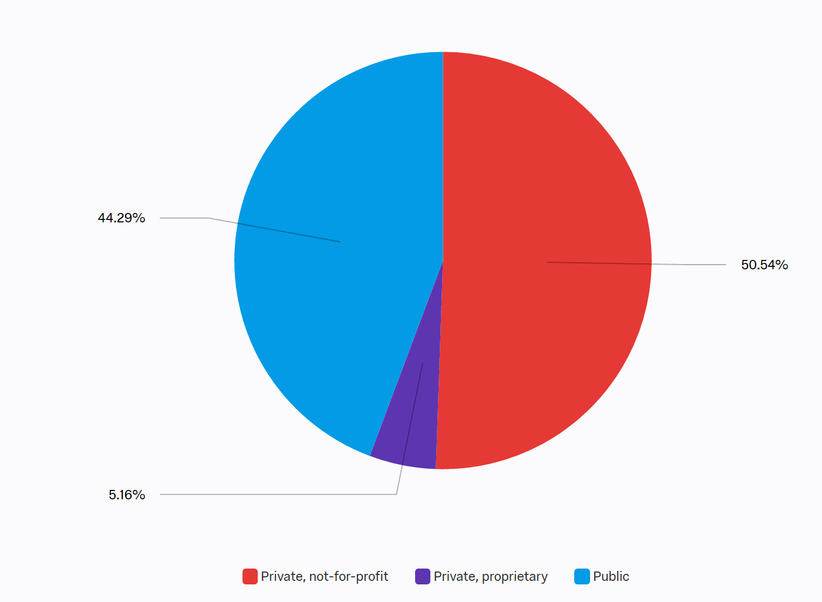
SURVEY RESPONDENTS
369 INSTITUTIONS RESPONDED
INSTITUTION TYPE
INSTITUTION CONTROL

Slide 3
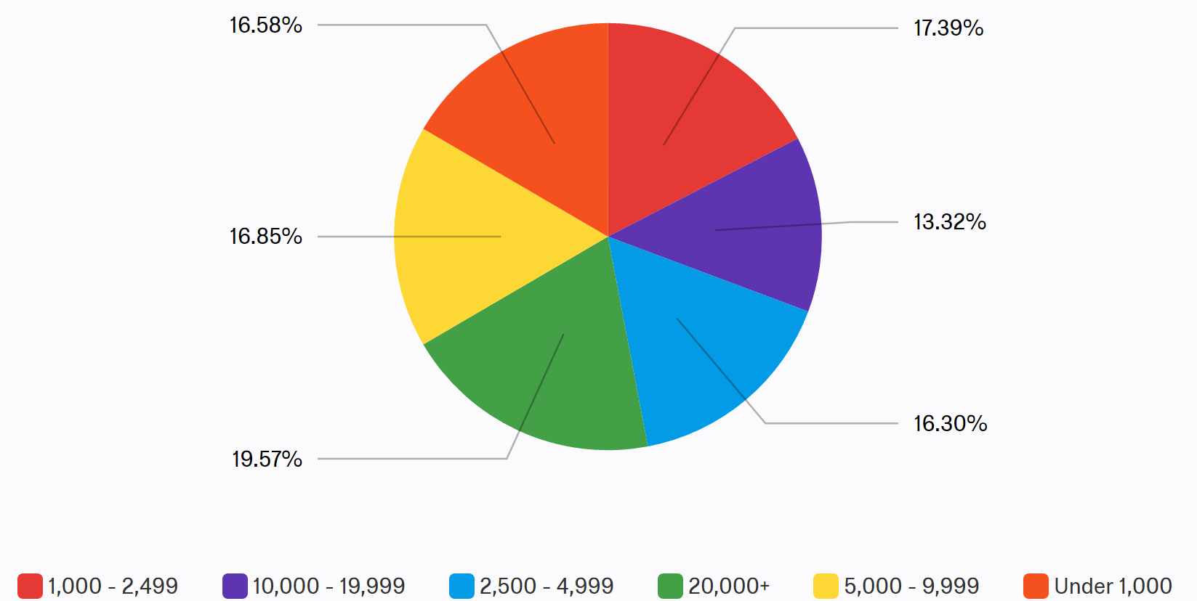
INSTITUTION SIZE

Slide 4
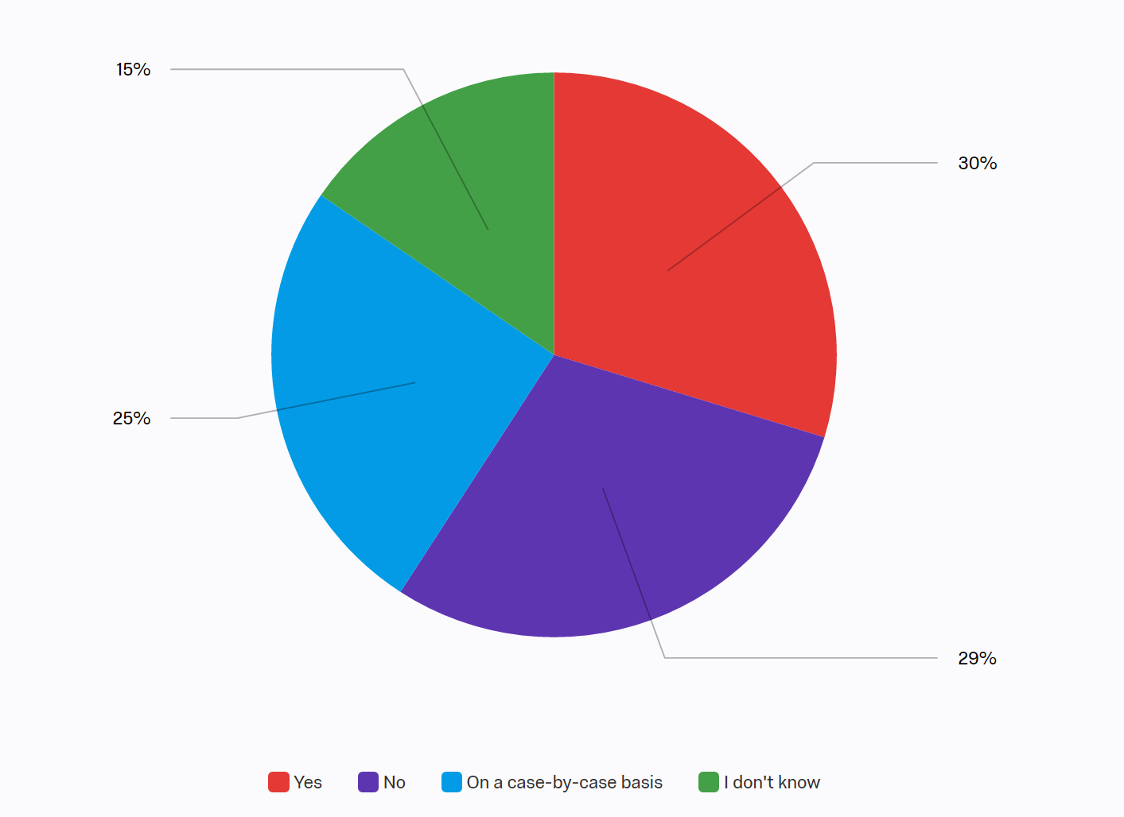
Q1 - Does your institution require completed undergraduate programs to be at least four years in duration for admissions eligibility into your graduate programs?

Slide 5
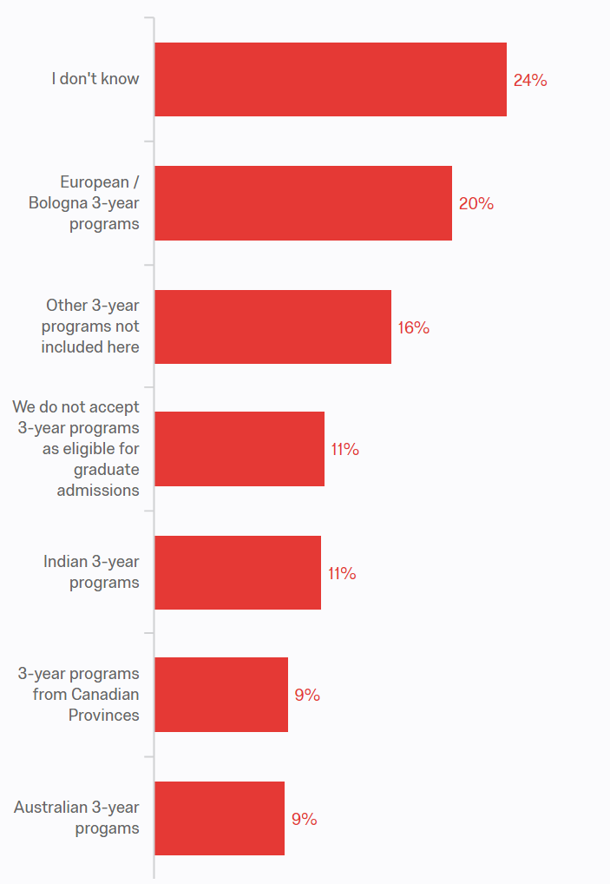
Q2 - If your institution ever considers 3-year bachelor's programs as eligible for graduate admissions, please select the type of 3-year programs below that you believe to be eligible:

Slide 6
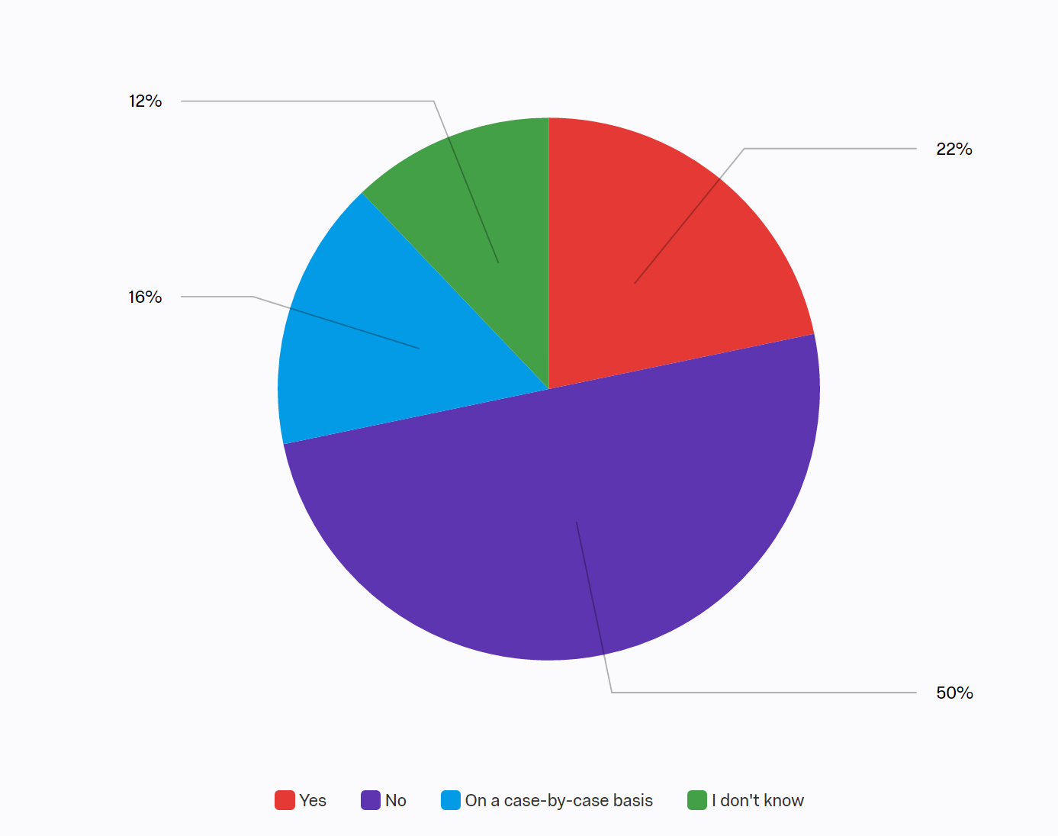
Q3 - For graduate admissions eligibility, does your institution require that completed undergraduate programs include specific General Education coursework?

Slide 7
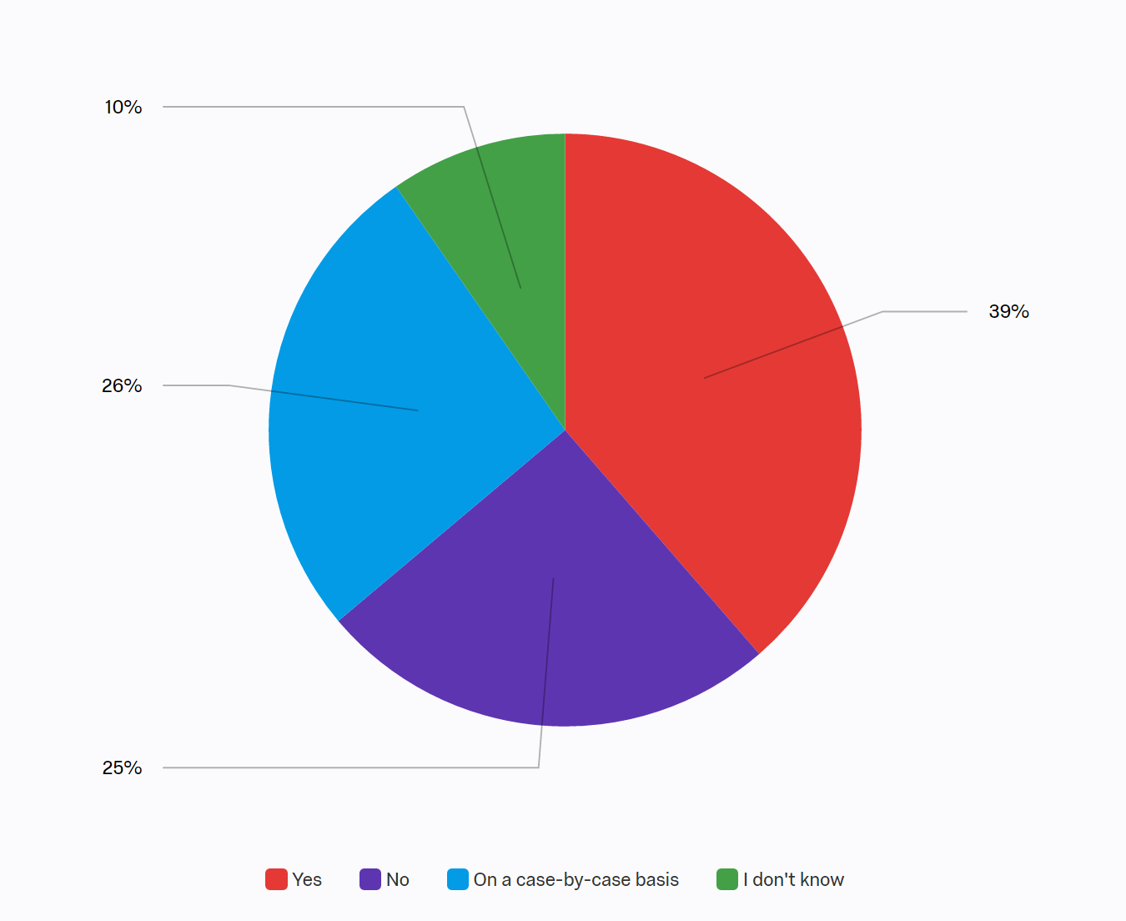
Q4 - For graduate admissions eligibility, does your institution require that completed undergraduate programs include Major-specific coursework?

Slide 8
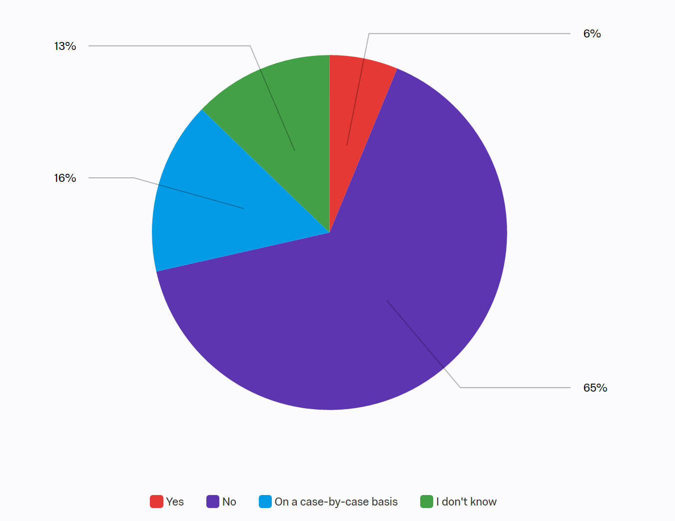
Q5 - For graduate admissions eligibility, does your institution require that completed undergraduate programs include specific Elective coursework?

Slide 9
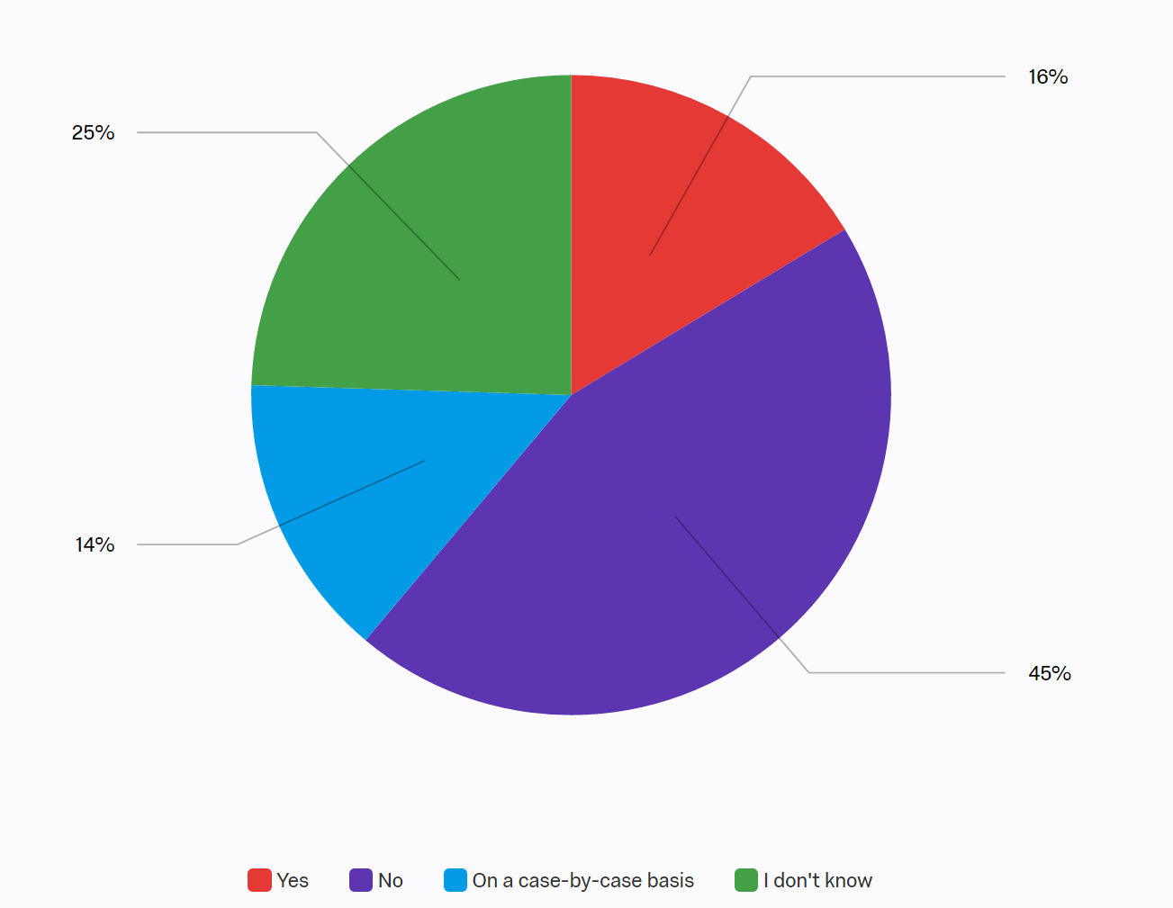
Q6 - Does your institution consider how international undergraduate programs provide access to graduate programs in the home country when determining eligibility for admissions to your graduate programs?

Slide 10
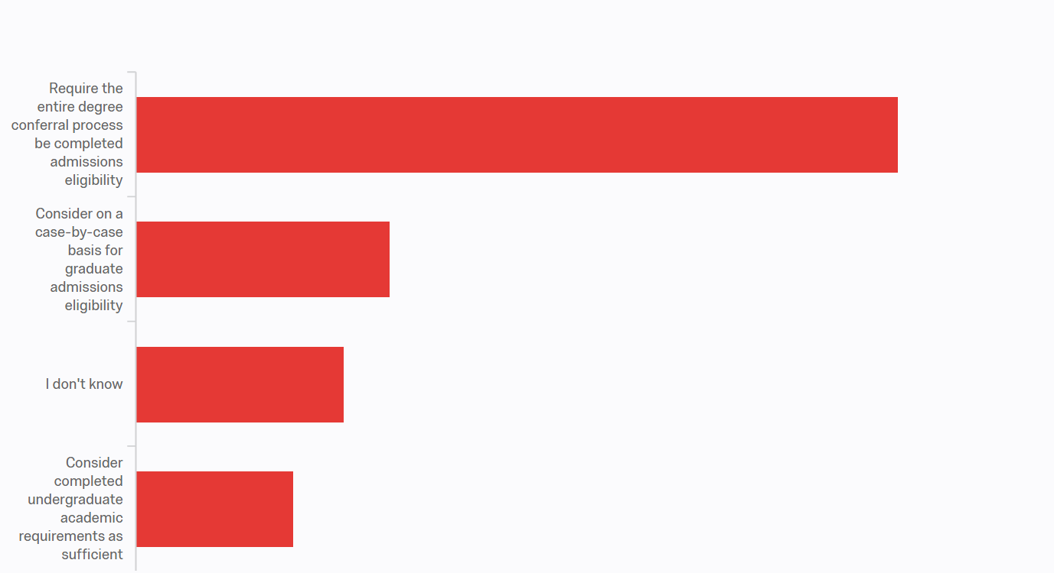
Q8 - From countries where undergraduate programs have multiple stages during the degree conferral processes, does your institution require that the entire degree conferral process be completed for graduate admissions eligibility or will you consider completed undergraduate academic requirements (such as coursework, thesis, etc.) as sufficient for eligibility?

