Slide 1
Social Media for Associations
AACRAO Leadership 2014
Tim Amyx
Director of Admissions & College Registrar
Volunteer State Community College, Gallatin, TN
TnACRAO Past-President & Webmaster
Incoming Program Committee Vice-Chair

Slide 2
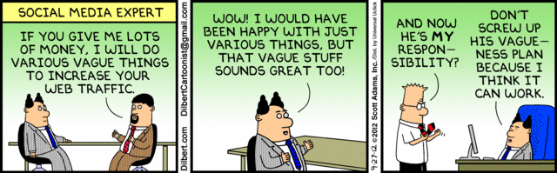
Social Media Expert
Notes:
Going to do this like Mark Twain. Too many excellent sessions full of resources and data, so I'm not going to compete. I'm just going to share my thoughts and ask you for yours.
Presented several times on social media. When looking back, they're all outdated even though they are fairly recent.
When I first started presenting, there was barely any research and few people on board. Now there's a ton of research and everyone is doing it.

Slide 3

What is Social Media?
The "Big Three"
Supporting Characters
Leveraging Social
Notes:
Because we have to is not a good reason. It's backwards thinking.
The need to have a social media presence is the new need to have a web presence.
Facebook, Twitter, LinkedIn
Pinterest, Instagram, Google+, others?
Yelp, Trip Advisor, Amazon, Yik Yak

Slide 4
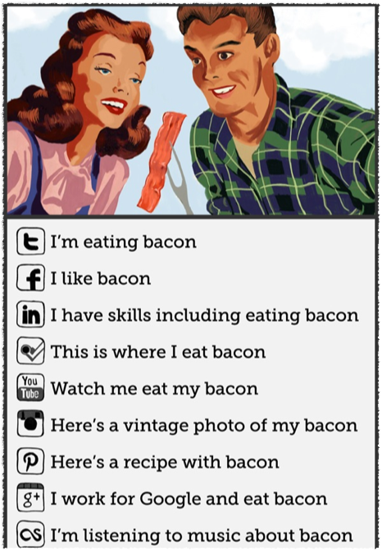
Social Media
explained with bacon
Notes:
Borrowed from Stan Demrrit

Slide 5
Brand Awareness
Coke
Campbell's Soup
McDonald's
Southwest Airlines
Nike
Your Association
Notes:
We don't need long MBA definitions of a brand. We know what it is. Don't confuse it with the tag line. It's the meaning or value behind the tag.
Take out a piece of paper. Write down each company's brand when you see the name.
Ask the brand of each company.
What's your brand?
You have to understand your brand before you can determine why you should move forward with any big activity

Slide 6
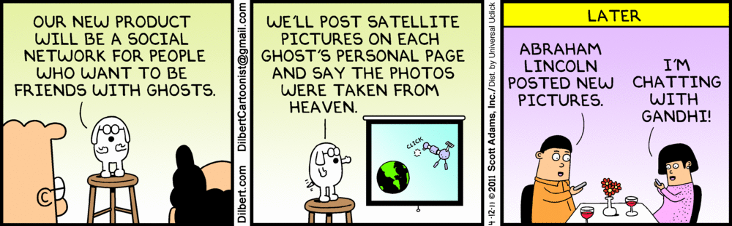
Dogbert
Notes:
Although Dogbert may not be the most ethical, he understands what he's doing and why.

Slide 7
Why? Oh, why?
Purpose
(or, What's the story, Morning Glory?)
Notes:
You should know the reason behind your interest in entering the social media arena.
Because everyone is doing it is not really a good enough reason (yet).
Even if that's your primary reason, you still need to decide why your social media effort will matter to your membership.

Slide 8
Users Want to Use
Where are your members already gathering?
What do they want to share?
What benefit will they get from sharing?

Slide 9
Posting with Purpose
Voice
Timing
Responsiveness
Notes:
Be authentic and interesting. Use a voice that speaks to your membership. (Boo boo orientation example.)
Make sure your content is fresh and relevant to your members. Rehashing old news won't cut it.
Interaction is the key component of social media. You have to interact in a timely manner. Don't create a new way to provide bad customer service.

Slide 10
Your Turn
What are you doing on your campus that could be applied successfully to your association?
What is your association doing that you think others would benefit by trying?
What do you plan to do next?
Notes:
Share answers with those at your table. Select something to share with the group. 10 mins.

Slide 11
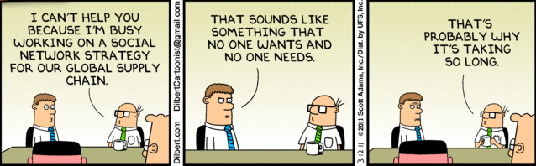
Parting Thought
Notes:
Be sure whatever you create has a purpose. If you don't need it, don't waste time doing it.

Slide 12
Find Me
facebook.com/tamyx
twitter.com/tamyx
linkedin.com/in/tamyx

