Slide 1
2017-18 FAFSA

Slide 2
Agenda
Goals
2017 – 18 FAFSA Changes
Outreach Resources
Discussion
Q&A

Slide 3
Goals
Share with you our high-level plan and approach.
Discuss when, how and what resources are used to communicate with your students and parents.

Slide 4
2017-18 FAFSA Changes
Submit a FAFSA® Earlier: Students will be able to file a 2017–18 FAFSA as early as Oct. 1, 2016, rather than beginning on Jan. 1, 2017. The earlier submission date will be a permanent change, enabling students to complete and submit a FAFSA as early as October 1 every year.
Use Earlier Income Information: Beginning with the 2017–18 FAFSA, students will report income information from an earlier tax year. For example, on the 2017–18 FAFSA, students (and parents, as appropriate) will report their 2015 income information, rather than their 2016 income information.

Slide 5
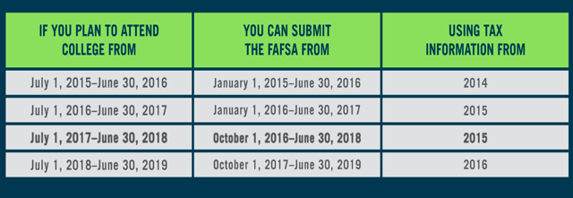
2017-18 FAFSA Changes

Slide 6
2017-18 FAFSA Outreach Resources
FSA will provide counselors and mentors with:
Language on the 2017-18 FAFSA that they can share with students and parents via emails, newsletters, etc. The language will focus on the availability of the 2017-18 FAFSA on October 1 and the use of 2015 tax information for the FAFSA. In addition, the language will contain information on securing an FSA ID over the summer.
A suggested calendar/timeline for outreach efforts
A calendar of when FSA resources re: the 2017-18 FAFSA will be available on www.FinancialAidToolkit.ed.gov
Timing: late-April 2016

Slide 7
Webinars
FSA will host several webinars for counselors and mentors to discuss the changes to the 2017-18 FAFSA and share the tools/resources we have/will have available to assist them in their outreach efforts.
Timing: late-April 2016 – Summer 2016

Slide 8
2017-18 FAFSA Completion Campaign
FSA will conduct a 2017-18 FAFSA Completion Campaign – which will include webinars, in-person events, social media, blog posts. We will ask counselors and mentors to help us carry our message to students and parents. (All of our resources will be available on www.FinancialAidToolkit.ed.gov.)
Timing: Mid-August 2016 – March 2017

Slide 9
Discussion
Timing: Are our materials available when you need them most?
Materials: Which resources do you use most often?
Materials: What is the one thing you wish we were providing?

Slide 10
Questions?

Slide 11
Thank you!

