Slide 1


Advancing Learning and Employment Records:
Join the LER Accelerator Cohort

Slide 2

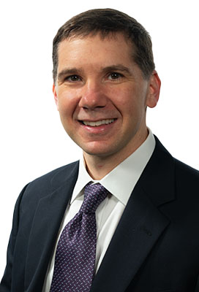

Melanie Gottlieb
Sean Bridgen
Kelly Hoyland
Executive Director, AACRAO
Associate Director for External and Institutional Partnerships, NACADA
Director, Post-Secondary Education & Workforce Programs, 1EdTech

Slide 3
What is the LER Accelerator?
The LER Accelerator launched in 2024 with support from Walmart. The effort aims to modernize how learning achievements and job skills are documented and recognized, helping to create a more transparent, efficient, and equitable system for both learners and employers.
The initiative seeks to boost the adoption of Learning and Employment Records (LERs) in postsecondary education by focusing on:
(1) overcoming implementation delays,
(2) raising awareness, and
(3) fostering collaboration.

Slide 4



Mission
Goals
Challenges
To accelerate the development and adoption of Learning and Employment Records (LERs) in post-secondary education.
● Expanding awareness of LERs
● Sharing best practices
● Establishing integrity in LER-credentialed systems
● Promoting interoperability
● Addressing technical hurdles
● Enabling long-term changes in the post-secondary landscape
● Slow adoption of
innovative credentials
● Administrative and
technical barriers
● Uncertainty about
market demand
● Policy inertia
● Interoperability challenges

Slide 5
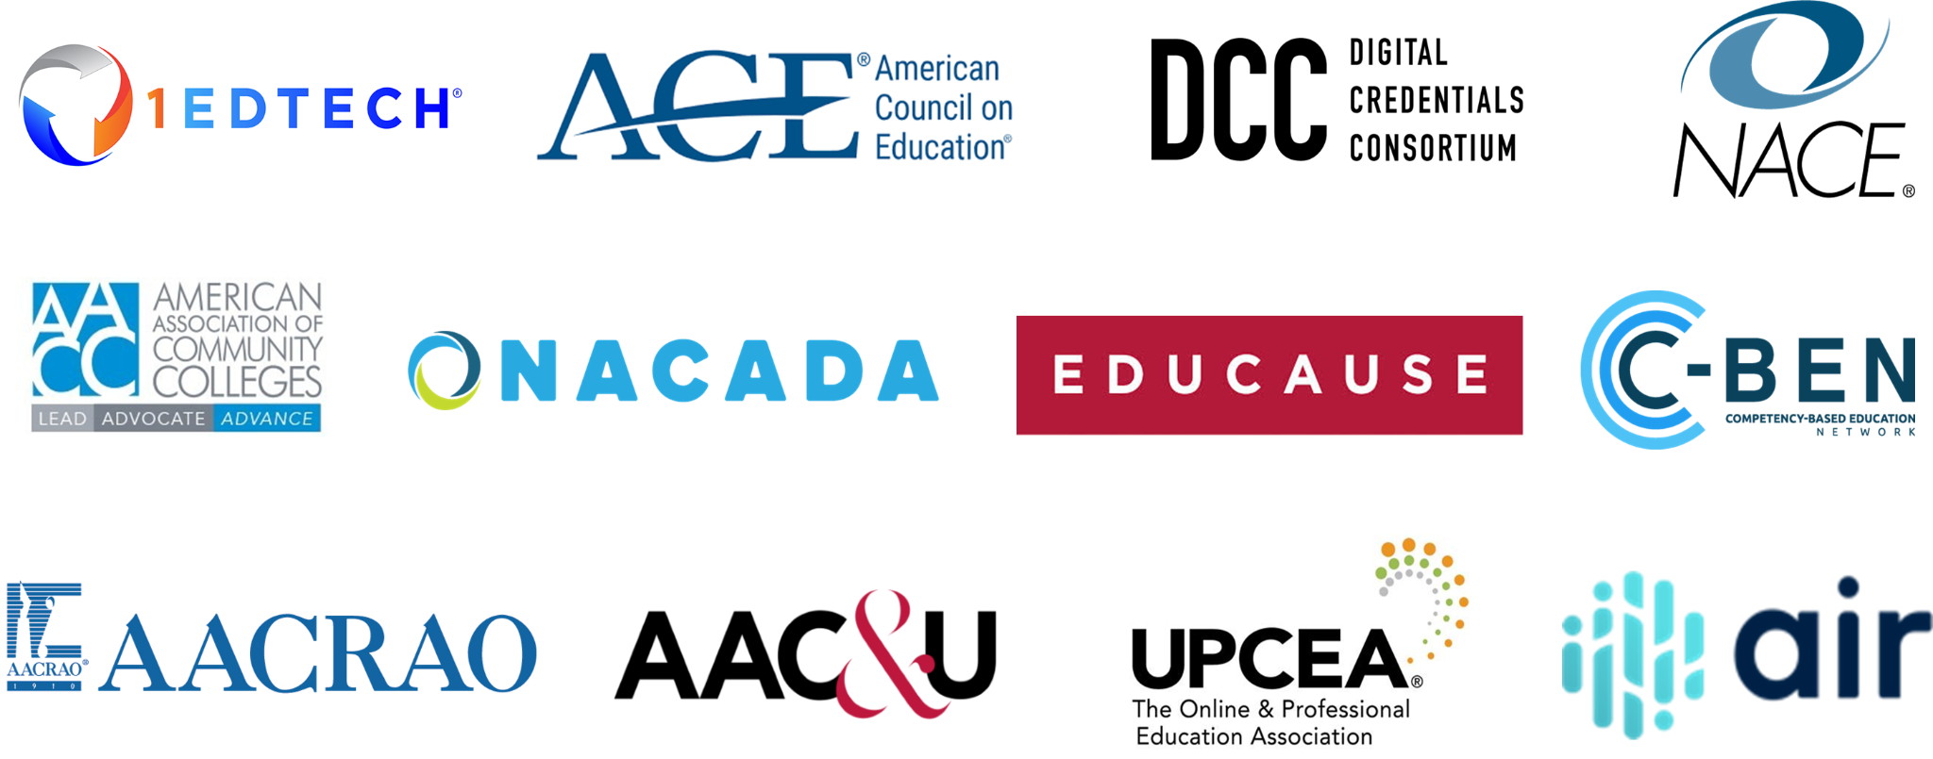
LER Accelerator Coalition Members

Slide 6



Key Strategies
Reducing the obstacles to
LER adoption
Fostering collaboration among educational associations
Advocating for changes in the issuance, verification, and consumption of postsecondary learning
Creating awareness of the need for skills centered credentials
Developing guidelines for universal
LER usage
Demonstrating successful models and examples that accelerate the creation and issuance of quality credentials

Slide 7
Key Initiatives
Comprehensive LER Resource Hub: Partnering with the Learn & Work Ecosystem Library to consolidate and curate resources in a shared repository, which will help institutions navigate the complex landscape of credentials and skills.
Explore the resources in the LER Accelerator inventory at: https://learnworkecosystemlibrary.com/special-projects/user-group-special-project-learning-employment-records-ler-postsecondary-accelerator-initiative/
Toolkits and Resources: Developing and disseminating guidance, best practices, models, and other resource materials to facilitate institutional exploration and adoption of LERs. Including shared statements on guiding principles and and case studies on integrity in LER systems.
Interoperability: Promoting interoperability and open data standards to ensure that different systems and frameworks can work together seamlessly.
Skills-Based Ecosystem: Exploring the relationship between learning outcomes and skill statements to create a narrative that supports faculty in recognizing their contributions to skill development.
Communities of Practice (CoPs): Establishing CoPs to foster collaboration among institutions, enhancing peer learning, and generating practical resources based on shared experiences.

Slide 8

Join the Cohort
Participate in a one-year cohort-based initiative on planning and developing LERs.
Institutions may be at any stage of LER implementation from those just beginning to develop LER concepts to those ready to scale existing projects.

Slide 9
Potential Project Types
State-Level Workforce Integration
  Development of accessible institutional strategies
  Creation of privacy preserving assessment tools
  Establishment of interoperable collaboration models
Example: Building a digital wallet, LER, comprehensive learner
record (CLR), or such related platform or transcript.
Learner-Centered Credential Innovation
  Implementation of learner-controlled credentials
  Leveraging the knowledge of learners to create credentials
  Integration of validated achievements
  Development of inclusive engagement strategies
Example: Developing a learner-tailored badging initiative
Systems Alignment and Governance
  Creation of privacy-protecting frameworks
  Development of secure validation protocols
  Establishment of interoperable standards
Example: Developing procedures, policies, and systems to
support an LER initiative. Developing protocols for data collection,
verification, and validation.
Credit/Non-Credit Integration
  Design of boundless credentialing models
  Development of quality assurance frameworks
  Creation of flexible credential pathways
Example: Creating a pathway from non-credit credential to degrees.
Skills-Based Curriculum Processes
  Development of transparent competency frameworks
  Creation of accessible skills taxonomies
  Integration of verified achievement data
Example: Mapping skills and competencies in courses to document
learning.
Vendor Collaboration
  Alignment with open standards
  Implementation of secure specifications
  Adoption of interoperable protocols
Example: Integrating existing systems for a digital wallet, LER,
comprehensive learner record (CLR) to enable interoperability.

Slide 10


What to Expect
Participating institutions will move through a planning process together, learning from and alongside each other. Institutions will also receive guided support from coaches who are experts in the field and tailored technical assistance.
Funding and Potential Implementation Support
Participating institutions will receive $10,000 - $15,000 to support their planning, with an opportunity for cohort participants in the planning phase to be invited to apply for a potential implementation phase.

Slide 11




Timeline: April 2025 - May 2026
April - May 2025
Ongoing
Virtual cohort launch
Monthly coaching sessions
for your institutional team
May - July 2025
Periodic
Institutional pre-assessment
Peer-to-peer learning
opportunities
Summer 2025
Spring 2026
In-person convening w/ experts
and TA providers
Preparing for implementation of
action plan
Fall 2025
April - May 2026
Development of an action plan for
your LER initiative
Finalize launch plan and virtual
cohort convening

Slide 12
How to Apply
To indicate interest in joining the cohort, an institution should submit a 2-4 page application that includes the following:
Project Description: Describe in detail the type of LER project the institution would like to advance during the planning period.
Value to Joining the Cohort: Briefly explain how participating in the LER Accelerator cohort will support your institution in achieving your goals.
Project Team: Identify project team members by name, title, dept/office, and email address. The project should have 1-2 senior/executive sponsors and a project lead who will have primary responsibility for setting and meeting the project’s goals and deliverables. Include additional team members.
See full request for proposals and instructions at: https://www.aacrao.org/docs/default-source/signature-initiative-docs/learning-mobility/cohort-rfp.pdf
Please address any questions to Julie Johnson, julie@strategyforwardadvisors.com and Michelle Mott, mottm.ctr@aacrao.org.
Submit your application Michelle Mott, mottm.ctr@aacrao.org by March 10th, 10 pm ET.
Selection Process: Proposals will be assessed on the criteria described above. Semi-finalist applicants may be asked to submit additional information and/or participate in an interview. Proposals will be reviewed by members of the LER Accelerator Coalition.
Candidates will be announced by April 8th, 2025.

Slide 13
Questions?
Thank you for attending!
For additional information about LER Accelerator, please visit
https://www.aacrao.org/our-work/learning-mobility/innovative-credentials/ler-accelerator.
Follow us on LinkedIn at linkedin.com/company/ler-accelerator/ for the latest updates from the coalition.
Explore the LER Accelerator Inventory resource hub and stay tuned for new tools, case studies, and insights from the coalition in the coming months.
https://learnworkecosystemlibrary.com/initiatives/ler-accelerator/

